Slide 1
ECOLOGICAL SUCCESSION

Slide 2
ECOLOGICAL SUCCESSION
Gradual process by which ecosystems change and develop over time.
Nothing remains the same and habitats are constantly changing.
There are two main types of succession, primary and secondary.

Slide 3
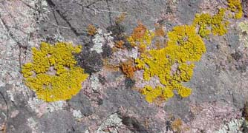
Primary Succession
Soil starts to form as lichens and the forces of weather and erosion help break down rocks into smaller pieces.
When lichens die, they decompose, adding small amounts of organic matter to the rock to make soil.

Slide 4
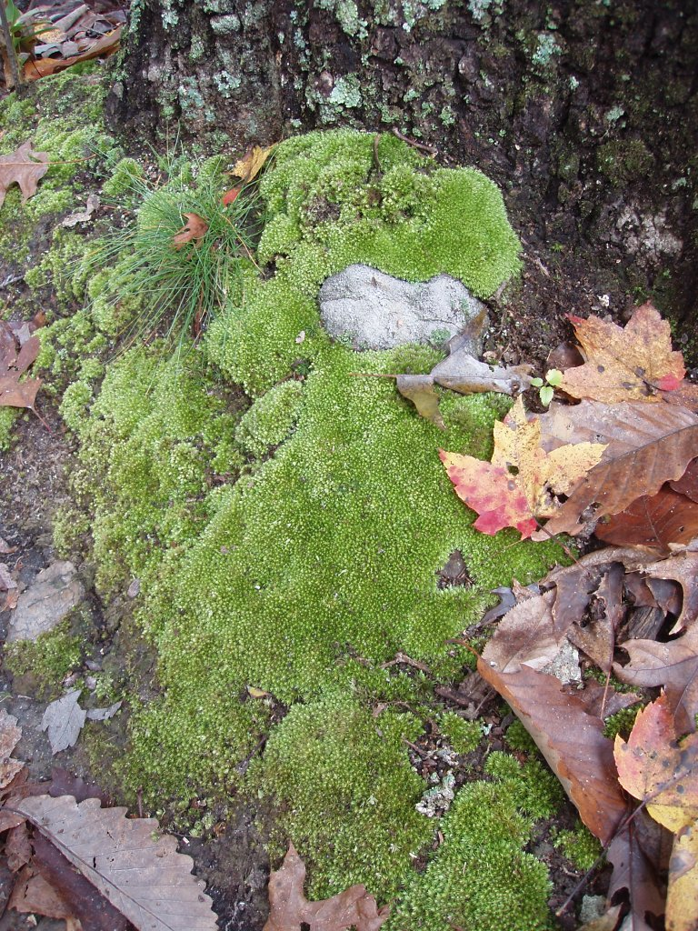
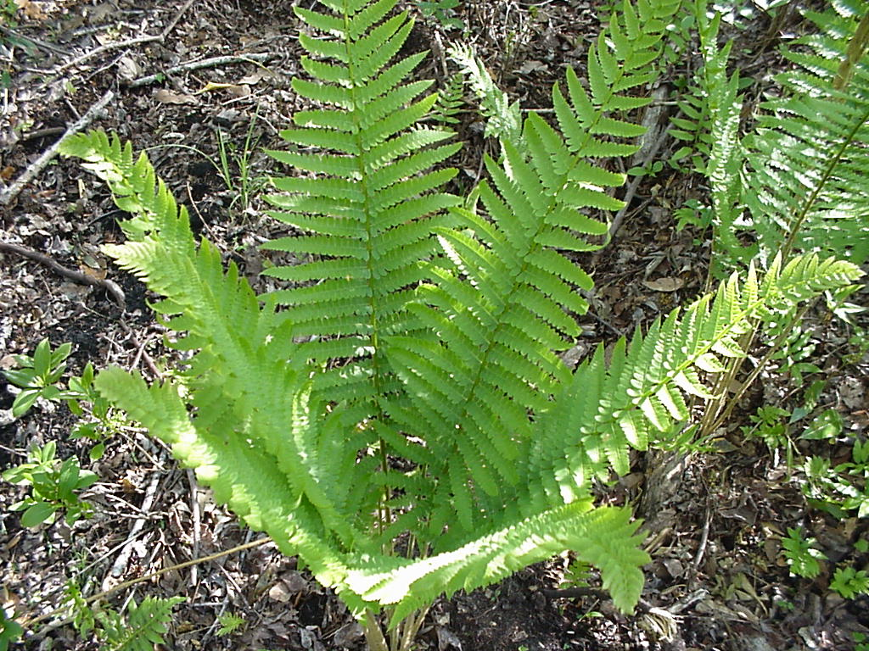
Primary Succession
Simple plants like mosses and ferns can grow in the new soil

Slide 5
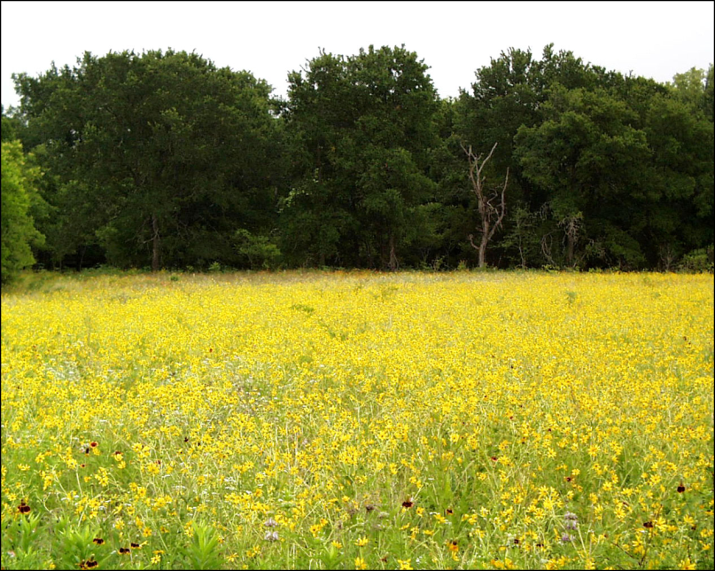
Primary Succession
The simple plants die, adding more organic material (nutrients) to the soil.
The soil layer thickens, and grasses, wildflowers, and other plants begin to take over.

Slide 6
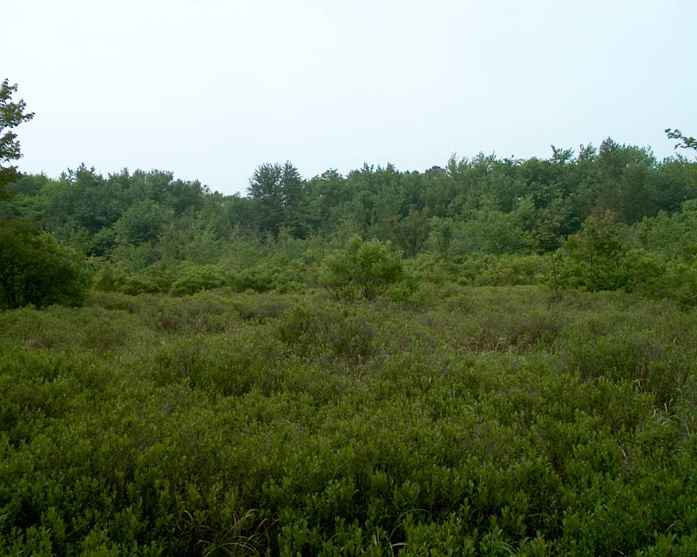
Primary Succession
These plants die, and they add more nutrients to the soil.
Shrubs and trees can survive now.
Insects, small birds, and mammals have begun to move into the area.
What was once bare rock, now supports a variety of life.

Slide 7
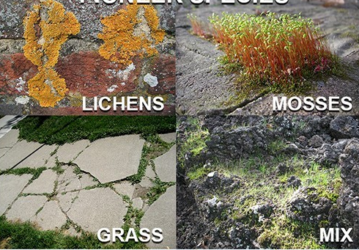
Primary Succession
Pioneer Species
Hardy species which are the first to colonize previously disrupted or damaged ecosystems.

Slide 8

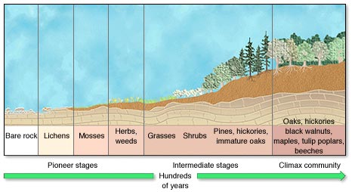
PRIMARY SUCCESSION

Slide 9
CLIMAX COMMUNITY
A climax community is a mature, stable community that is in the final stage of ecological succession.
In an ecosystem with a climax community, the conditions continue to be suitable for all the members of the community.
Climax species - that are best adapted for the area and will persist after succession has finished - until another disturbance clears the area.

Slide 10
Climax Community
A stable group of plants and animals that is the END RESULT of the succession process.
Does not always mean big trees!
Grasses in prairies
Cacti in deserts

Slide 11
THREATS TO CLIMAX COMMUNITIES
The threats which could change climax communities
Forest Fires
Humans building cities and roads
Flooding
Volcanic eruptions
Clearing a community for agricultural purposes

Slide 12
Secondary Succession
Begins in a place that already has soil and was once the home of living organisms.
Occurs faster and has different pioneer species than primary succession.
Example: after forest fires

Slide 13
SECONDARY SUCCESSION
FEATURES
Succession that follows disruption of a pre-existing community.
Organisms are destroyed but the soil is safe.
The soil already contains the seeds of weeds, grasses, and trees. More seeds are carried to the area by wind and birds.
Succession begins again but the primary species are different.
Because soil is present, this succession is faster.

Slide 14
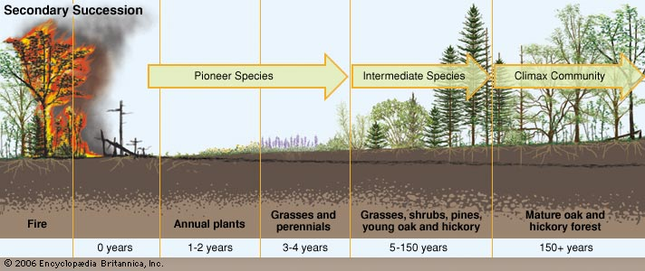
SECONDARY SUCCESSION

Slide 15
Ecosystem

Slide 16
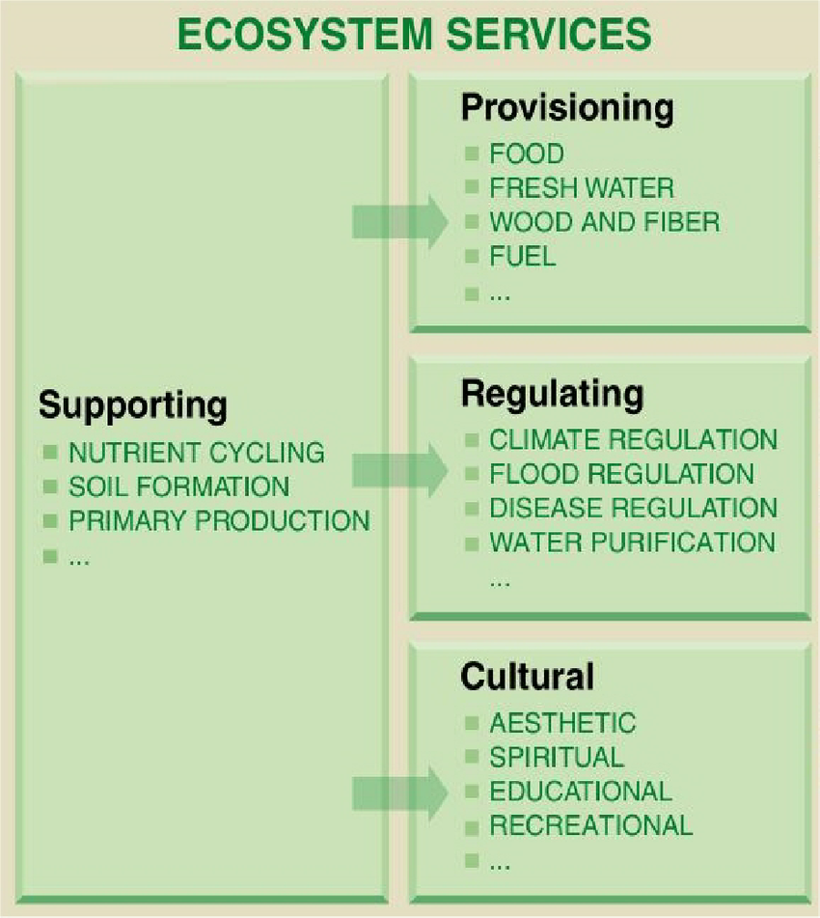

Slide 17
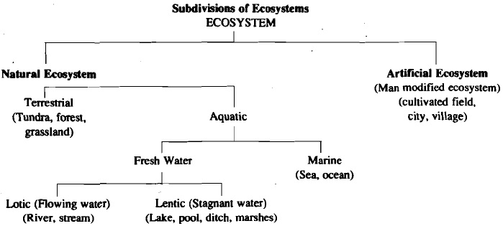

Slide 18
Case Study
Effect of human activities on the Ecosystem
The Day it Rained cats in Borneo ….

Slide 19
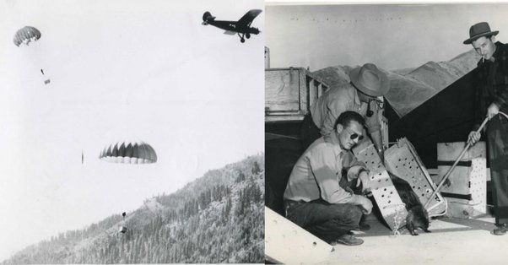
Operation Cat Drop
Cats were delivered in crates, dropped by parachute to a remote village in Sarawak, Borneo.
By the United Kingdom's Royal Air Force

Slide 20
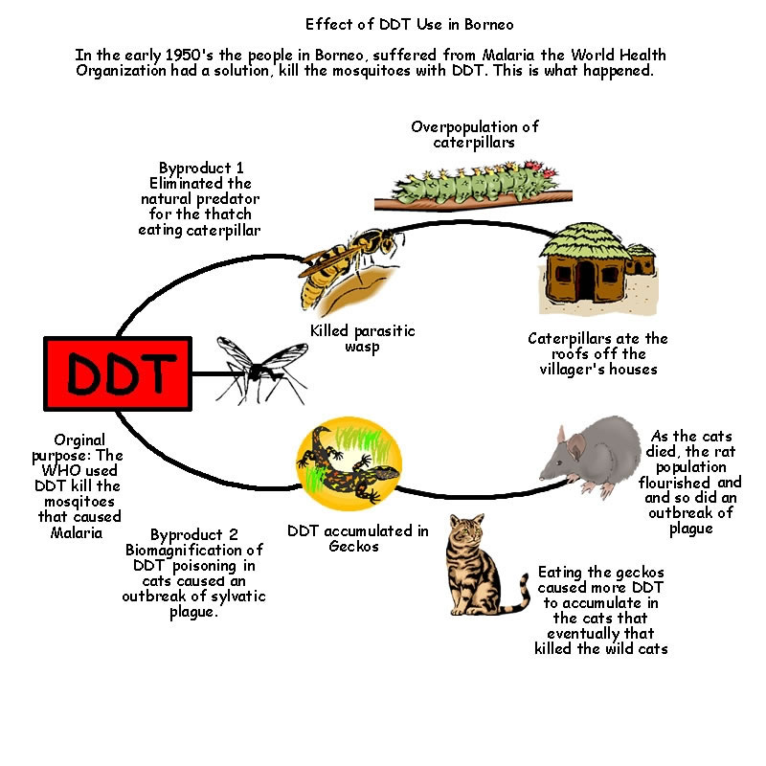

Slide 21
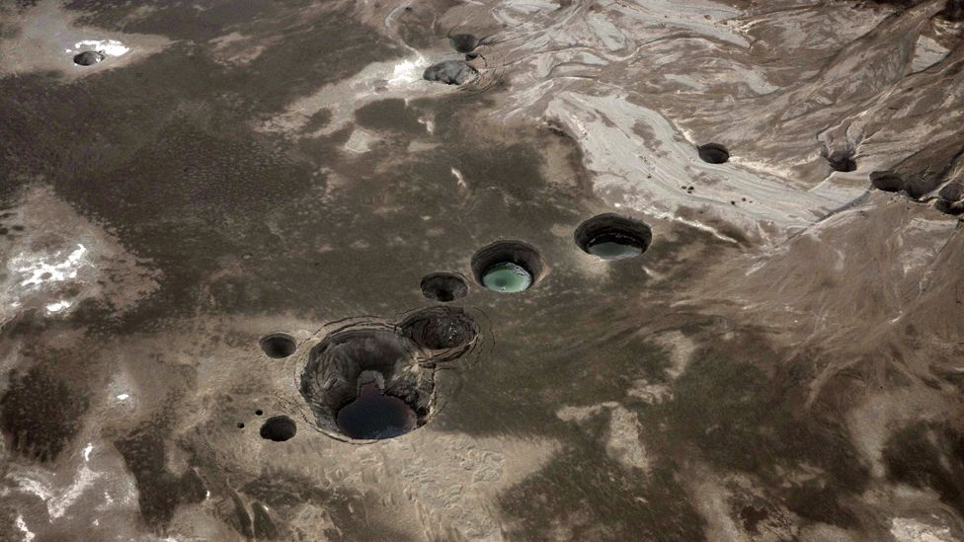

Slide 22
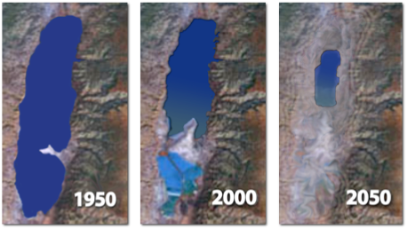
The Dying of the Dead Sea
Dead Sea is the lowest point on the planet – almost 400m below sea level
shrinking at an alarming rate - the surface level is dropping more than a metre (3ft) a year.
the planet's lowest point is being recalibrated on an annual basis.

Slide 23
The Dead Sea
a fragile natural cycle: it gets fresh water from rivers and streams from the mountains that surround it and loses it by evaporation.
The evaporation process, combined with its rich salt deposits, account for its extraordinary—up to 33 percent—salinity

Slide 24
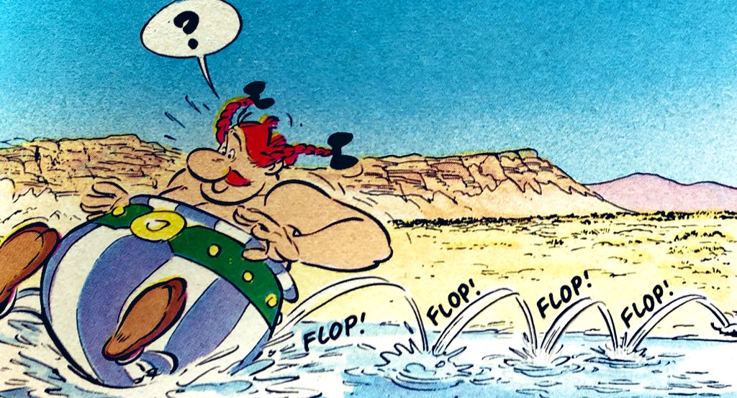
The Dying of the Dead Sea
In the 1960s, Israel built an enormous pumping station on the banks of the Sea of Galilee, diverting water from the upper Jordan,
In the 1970s Jordan and Syria began diverting the Yarmouk, the lower Jordan River’s main tributary.
It needs an infusion of 160 billion gallons of water annually to maintain its size;
it gets around10 % of it

Slide 25
The Dying of the Dead Sea
Dead Sea helps support one of the world’s most complex and vibrant ecosystems
About 500 million birds representing at least 300 species take refuge here during a biannual great migration from Africa to Europe and back again
As the Dead Sea recedes, the springs that feed the oases are moving along with it

Slide 26
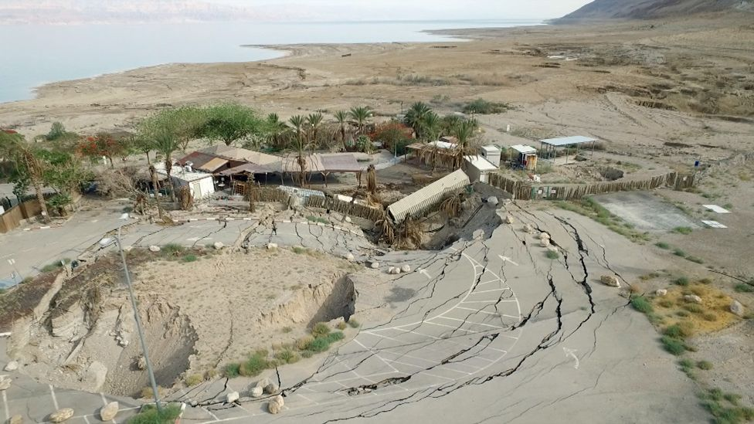
Sinkholes
Underground salt deposits left behind by the sea as it retreats either collapse into huge chasms or dissolve when fresh water seeps underground and causes the ground above to give way.

Slide 27
The Dying of the Dead Sea
Dead Sea is a symptom of sickness in the management of water resources.
The saving of the Dead Sea will be a good indication that we moved away from sickness to a healthy environment."

Slide 28
ECOLOGICAL FOOTPRINT
What is the Ecological Footprint?
a resource accounting tool to find, how much of the biological capacity of the planet is required by a given human activity or population?
What does the Ecological Footprint measure?
measures the amount of biologically productive area needed to provide for everything people use and absorption of the waste we generate.
Biologically productive area includes cropland, forest and fishing grounds, and do not include deserts, glaciers and the open ocean.

Slide 29
ECOLOGICAL FOOTPRINT
Unit :global hectares
What is biocapacity?
the ability of an ecosystem to produce useful biological materials and to absorb carbon dioxide emissions.
What is overshoot?
occurs when a population’s demand on an ecosystem exceeds the capacity of that ecosystem to regenerate the resources it consumes and to absorb its carbon dioxide emissions.

Slide 30
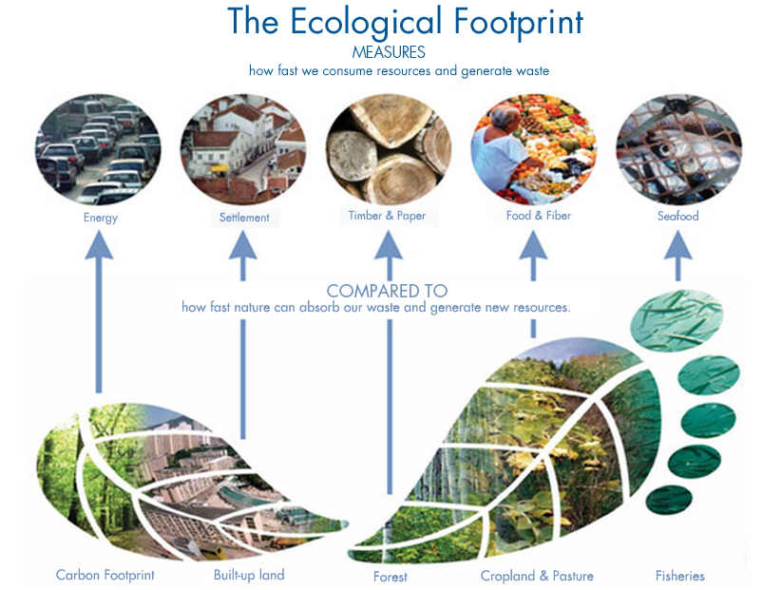

Slide 31
CHARACTERISTICS
Larger the footprint – more is the consumption of natural resources – more is the environmental degradation.
Ecological footprint – can be many times the area of the city or country.
Most of the world’s cities have ecological footprint more than one Earth.

Slide 33
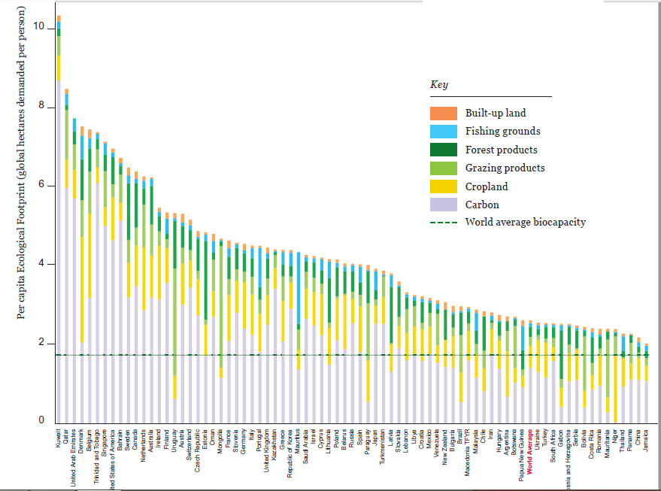

Slide 34
The world's ecological footprint 2022,
2.7 global hectares per person, of which 60% is carbon Footprint.
This led to an average per-person Ecological Footprint worldwide of 2.7 global hectares (gha), compared to 1.6 gha per person of available biocapacity.

Slide 35
Earth Overshoot Day has moved from late September in 1997 to August 2 in 2017
August 1 in 2018,
July 29 in 2019
August 22 in 2020
July 28, 2022
Move the date towards Sustainability
If we moved Earth Overshoot Day back 4.5 days every year, we would return to using the resources of one planet by 2050.

Slide 36
https://www.footprintcalculator.org/

Slide 37
Carbon footprint
The total amount of greenhouse gases produced directly and indirectly support human activities, usually expressed in equivalent tons of carbon dioxide (CO₂)
The world average is about 4.79 tons of carbon dioxide per person.

Slide 38
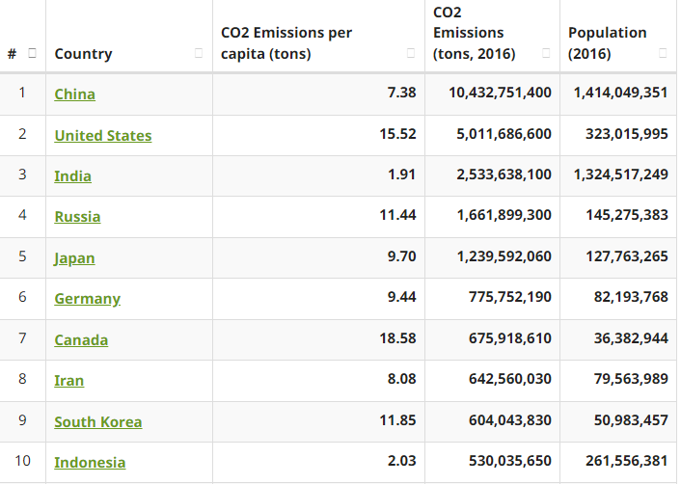
Countries that belch out the most CO₂ per capita
Qatar - 35.73 tonnes
Curacao - 30.43
Latvia - 22.94
Bahrain - 21.8
United Arab Emirates - 19.31
Trinidad and Tobago - 17.15
Malaysia - 16.57
Saudi Arabia - 16.4
Guatemala - 16.25
United States - 16.22

Slide 39
Countries that belch out the least CO₂ per capita
Denmark - 0.06 tonnes
Finland - 0.09
Nigeria - 0.1
Estonia - 0.11
South Sudan - 0.13
Myanmar - 0.14
Tanzania - 0.2
Zambia - 0.2
Netherlands - 0.21
Togo - 0.24

Slide 40
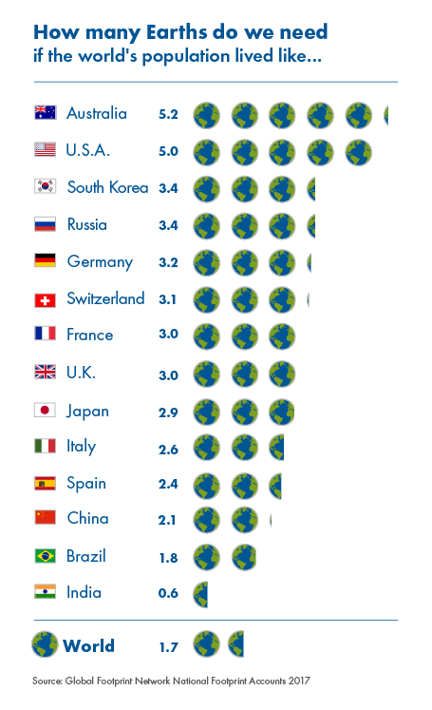

Slide 41
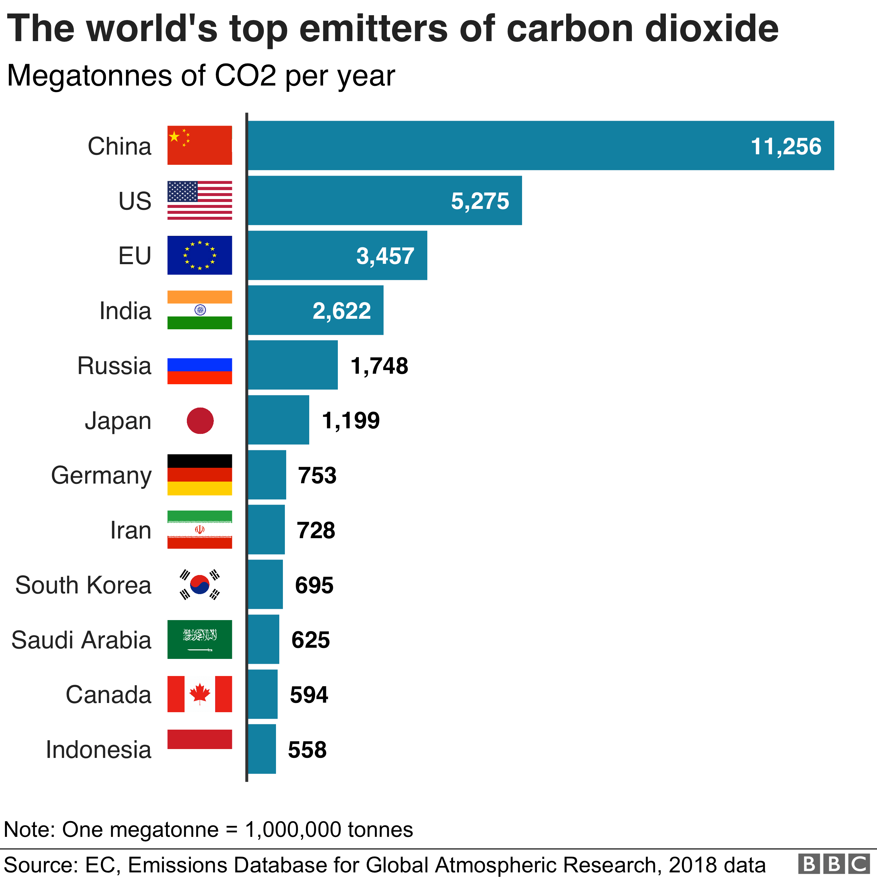

Slide 42
What's your diet's carbon footprint?
https://www.bbc.com/news/science-environment-46459714

Slide 43
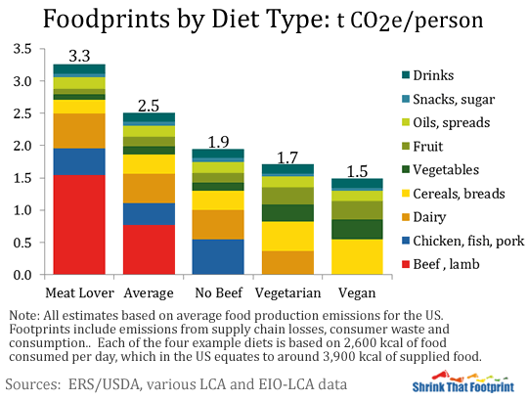
Top Tips for Reducing your Carbon Footprint
The carbon footprint of a vegetarian diet is about half that of a meat-lover’s diet.

